Slide 1
Intro to Unix / Linux
Michael Jochum, PhD Postdoctoral Research Associate Department of Obstetrics & Gynecology Baylor College of Medicine 1 Baylor Plaza, Houston TX 77401 email michael.jochum@bcm.edu

Slide 2


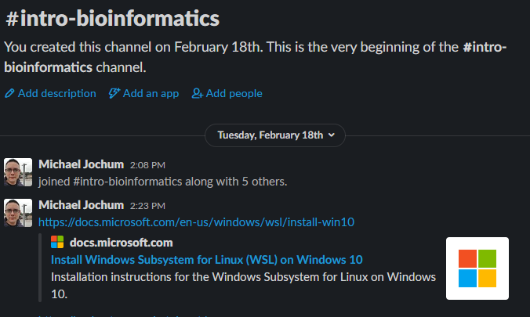
Introduction
Meeting time 2-4pm Wednesdays via zoom
Download
Join the

Slide 3
“Five things I wish I knew when I started getting into bioinformatics”
Fundamentals and concepts are important, not details
Don’t let yourself become paralyzed by options
Try to find a bioinformatics community to be a part of
Good documentation is for science, you, and the community
Be aware that you will often need to let some things go 😕
https://astrobiomike.github.io/about/

Slide 4
Objectives
Get a working Unix environment
Introduce some basic commands
Redirectors and wildcards
Apply some commands to some powerful everyday examples

Slide 5
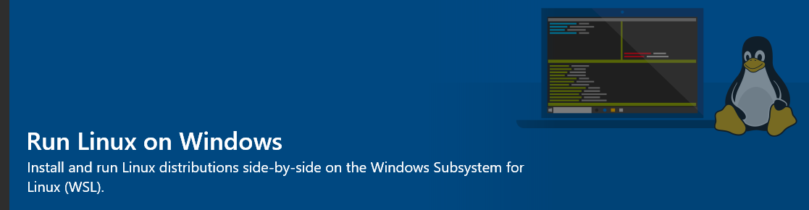

Windows Subsystem for Linux
Open "Turn Windows features on or off" in the start menu
select "Windows Subsystem for Linux", click OK.
Restart your machine.
Open the Microsoft Store and select your favorite Linux distribution.

Slide 6
Windows Subsystem for Linux

Slide 7
Windows Subsystem for Linux

Slide 8
Windows Subsystem for Linux

Slide 9
Windows Subsystem for Linux

Slide 10
Mac Users
Just open the terminal.

Slide 11
Now, let's get started!
I would like you to blindly copy and paste the following commands into your terminal window. This is so that we are working in the same place with the same files.
cd ~
curl -L -o unix_intro.tar.gz https://ndownloader.figshare.com/files/15573746
tar -xzvf unix_intro.tar.gz && rm unix_intro.tar.gz
cd unix_intro

Slide 12
Let’s talk
The Unix file-system structure
Absolute vs relative path
BONUS ROUND: Tab-completion is our friend!
Moving around
Working with files
Copying, moving, and renaming files
Working with directories
Redirectors and wildcards

Slide 13
Summary
Command | Function
date | prints out information about the current date and time
head | prints out the first lines of a file
pwd | prints out where we are in the computer (print working directory)
ls | lists contents of a directory (list)
cd | change directories
head | prints the first lines of a file
tail | prints the last lines of a file
less | allows you to browse a file (exit with q key)
wc | count lines, words, and characters in a file
cp | copy a file or directory (use with caution)
mv | mv a file or directory (use with caution)
rm | delete a file or directory (use with caution)
mkdir | create a directory
rmdir | delete an empty directory
Characters | Meaning
. | specifies the current working directory
/ | the computer’s root location
~/ | the user’s home location
../ | specifies a directory one level “above” the current working directory
| | a “pipe” allows stringing together multiple commands
> | sends output to a file (overwrites target file)
>> | sends output to a file (appends to target file)
* | represents any character appearing any number of times
? | represents any character appearing only once

Slide 14

Six glorious commands
Command | Function (base-usage)
cut | cuts columns from tables
grep | finds matching text and returns lines
paste | sticks columns or files together horizontally
sed | search and replace
awk | good for filtering columns and calculations
tr | swap characters for other characters (translate)

Slide 15
Linux command line resources
https://ubuntu.com/tutorials/command-line-for-beginners#1-overview
https://www.hostinger.com/tutorials/linux-commands
https://maker.pro/linux/tutorial/basic-linux-commands-for-beginners

